Slide 1








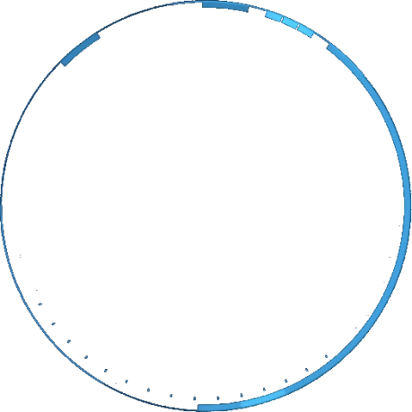


UrbanSphere : Where Quality Meets Location
Find Your Perfect Place to Call Home
Smart Insights for Better Living
Shivam

Slide 2
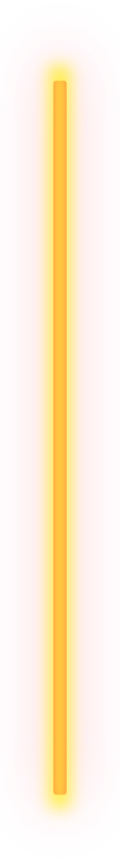


UrbanSphere : Where
Quality Meets Location
Find Your Perfect Place to Call Home
Team Airavata

Slide 3



Problem Statement:
Finding the right neighbourhood to live in can be tough,
especially when you need to consider factors like air and
water quality, safety, and access to things like parks, schools,
hospitals, and grocery stores. Other important things—like
nearby gyms, salons, green spaces, roads, and even water
management—also make a big difference in the quality of
life, but it's hard for people to get all this information in one
place.
UrbanSphere makes it easier by giving a clear, simple ranking of
different areas based on all these important factors. This
helps people find the neighbourhood that best fits their
lifestyle. Plus, by highlighting areas that need improvement,
UrbanSphere provides useful insights for local governments,
helping them target improvements to make every community a
better place to live.

Slide 4


Project Objectives

Slide 5
Project Objectives
Rank Neighbourhoods: Evaluate sub-districts based on factors like air quality, crime rates, parks, schools, healthcare, utilities, and infrastructure.
Keep Data Updated: Continuously refresh
neighbourhood data to ensure rankings and
recommendations are always accurate.
01.
02.
Identify Areas for Improvement: Highlight
underdeveloped neighbourhoods to guide local
governments in targeted improvements.
Promote Urban Development: Encourage balanced
growth by helping local authorities improve
underserved areas.
03.
04.

Slide 6
Features

Slide 7




Key Features:
Neighbourhood Rankings:
Role-Based Access Control (RBAC)
Rank sub-districts based on quality-of-life factors like air quality, crime rates, parks, schools, hospitals, utilities, and
infrastructure.
Offer different access levels for users
(homebuyers, real estate agents,
government officials) to ensure relevant
data is shown based on their role.
Area Improvement Insights:
Personalized Property Recommendations:
Identify underdeveloped areas and
provide actionable data to local
governments for urban planning and
infrastructure improvements.
Provide customized suggestions for neighbourhoods based on users' preferences, such as proximity to
amenities, safety, and lifestyle needs.

Slide 8
How UrbanSphere stands out and is
better than other platforms:
Holistic Neighbourhood
Evaluation:
Actionable Insights for Development:
Transparency in
Rankings
Unlike traditional platforms, UrbanSphere
ranks neighbourhoods on factors like air
quality, water management, crime rates,
parks, and utilities (gyms, salons, grocery
stores), giving a full picture of livability.
UrbanSphere provides valuable data to help local governments identify
underdeveloped areas and make
targeted improvements.
Users can easily see how
neighbourhoods are ranked and what factors influence the score.

Slide 9

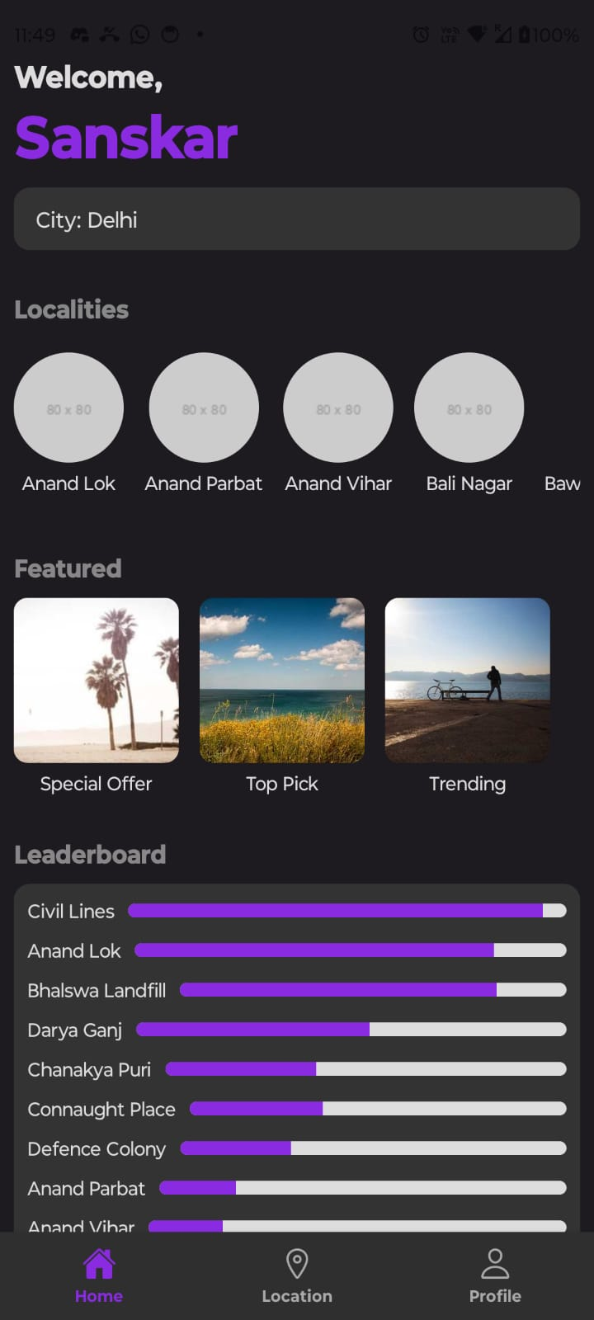
Mobile Interface
The UrbanSphere mobile app, built with React Native, offers a
seamless cross-platform experience on both iOS and Android devices. Users can easily search for specific sub-districts, view a
leaderboard of top-ranked neighbourhoods, and explore interactive
graphs and insights that break down key factors like air quality,
crime rates, and amenities. The app’s intuitive design ensures
smooth navigation, allowing users to quickly compare neighbourhoods and make informed decisions based on real-time data and
personalized recommendations.

Slide 10

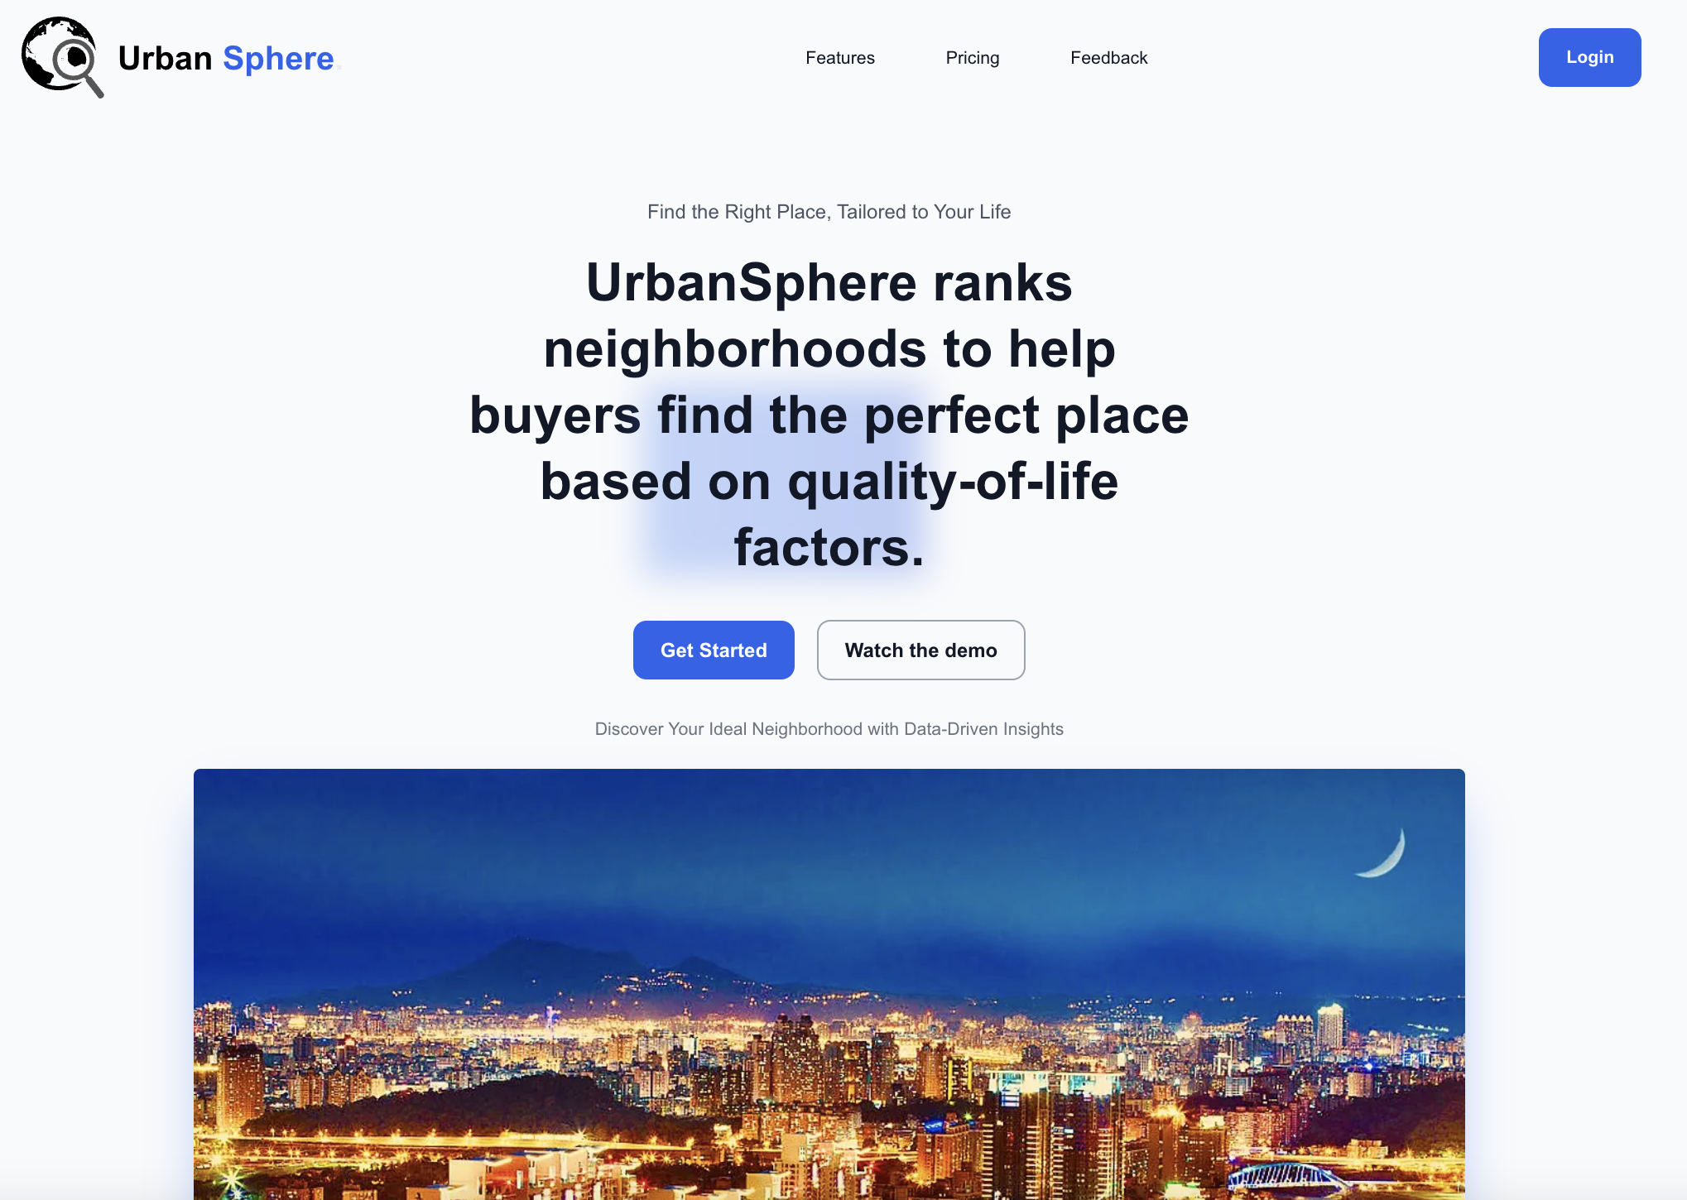
Desktop Interface
The UrbanSphere desktop interface is built using Next.js, providing a fast, responsive, and highly optimized experience for users. The platform offers a clean and intuitive
layout with easy navigation to search for
sub-districts, view leaderboards, and
explore detailed graphs and insights. With its server-side rendering capabilities,
Next.js ensures fast load times and smooth performance, making it easy for users to
access real-time neighbourhood rankings and data visualizations. The desktop interface is designed to deliver an engaging and
informative experience, with detailed
information on air quality, crime rates,
parks, and more, all presented in a
user-friendly format.

Slide 11




Our Team:-
Sanskar Soni
Shivam Singh
Parth Agarwal
Ashish Verma

Slide 12



Thank you

